Slide 1

openQA
Fully automated testing
Next → how it works
  Installation and upgrade testing
  Daily regression testing
  Application & network testing
  benchmarking
Overview of test results along with screen shots and video
Notes:
openQA is a automated testing system which runs daily tests on the openSUSE development tree 'Factory'.

Slide 2
How does it work?
Next → Screenshots
Boot ISO in VM (KVM or Qemu)
Give pre-defined input
Take screenshots of process
Compare screen shots with reference
Show results in web interface
Notes:
It works by booting up a ISO image (which is automatically generated daily from the Open Build Service) in a Virtual Machine. It installs it, boots, starts some applications and does a few simple actions. It takes screenshots during that process. It will then compare the screenshots it got with what was expected and thus know the test results.

Slide 3
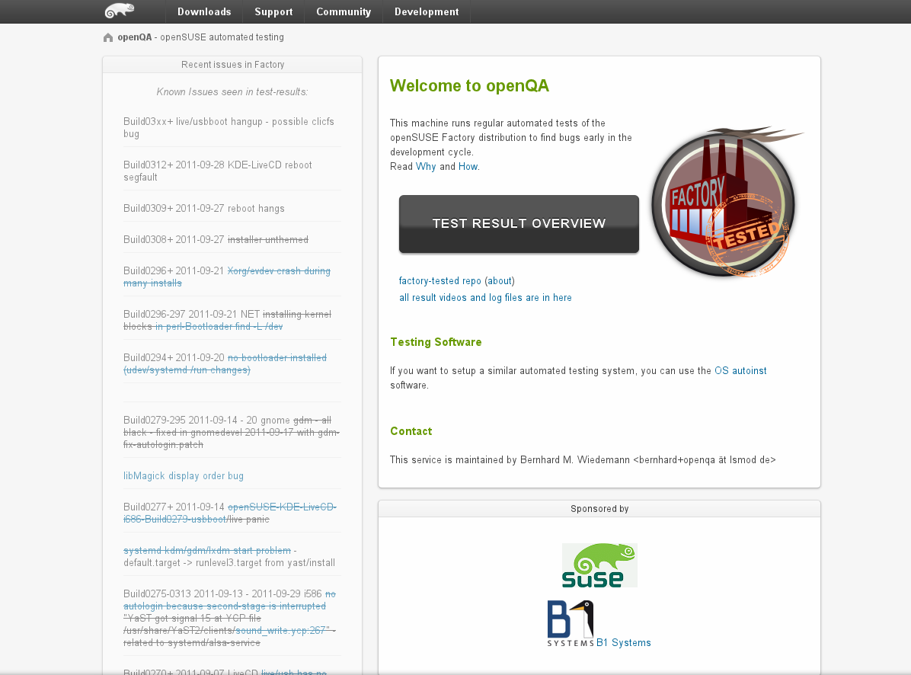
Welcome to the openQA web interface openQA automated testing framework
Notes:
This is the main interface of openqa.opensuse.org where you can check the test results.

Slide 4
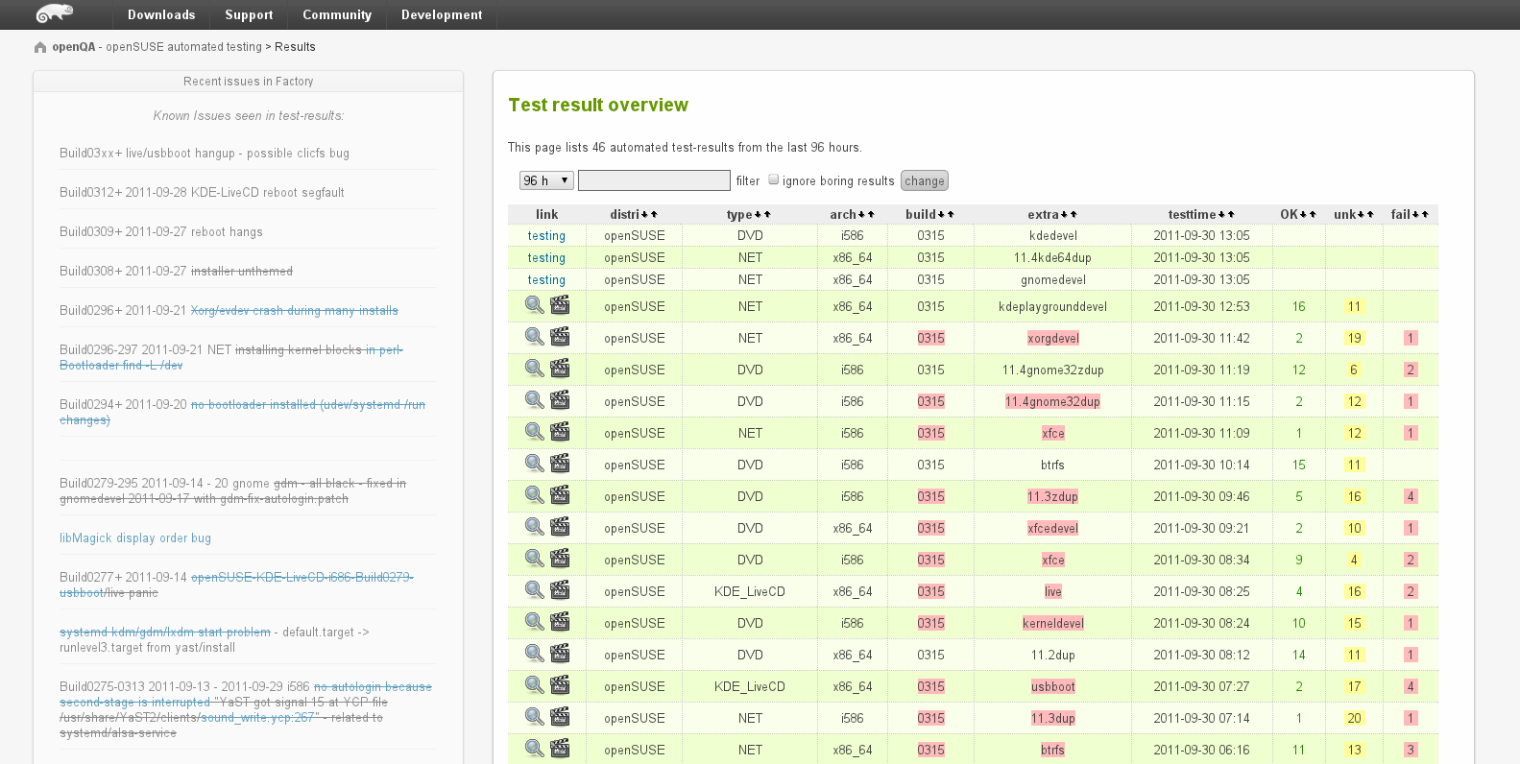
Overview of all tests ran on openSUSE Factory openQA automated testing framework
Notes:
Here is a list of tests which has run and the results.

Slide 5
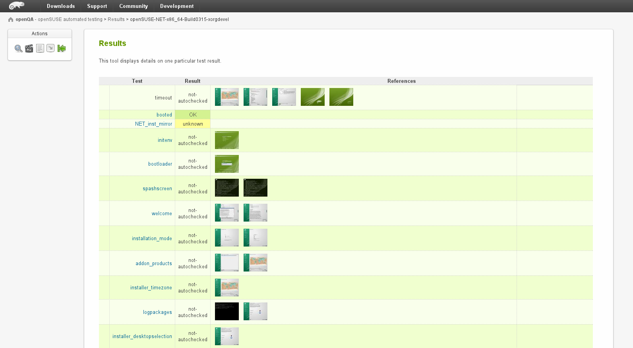
In-dept results of a test from openQA automated testing framework
Notes:
You can see the details of a test, and as you can see you can download and inspect the screenshots.

Slide 6
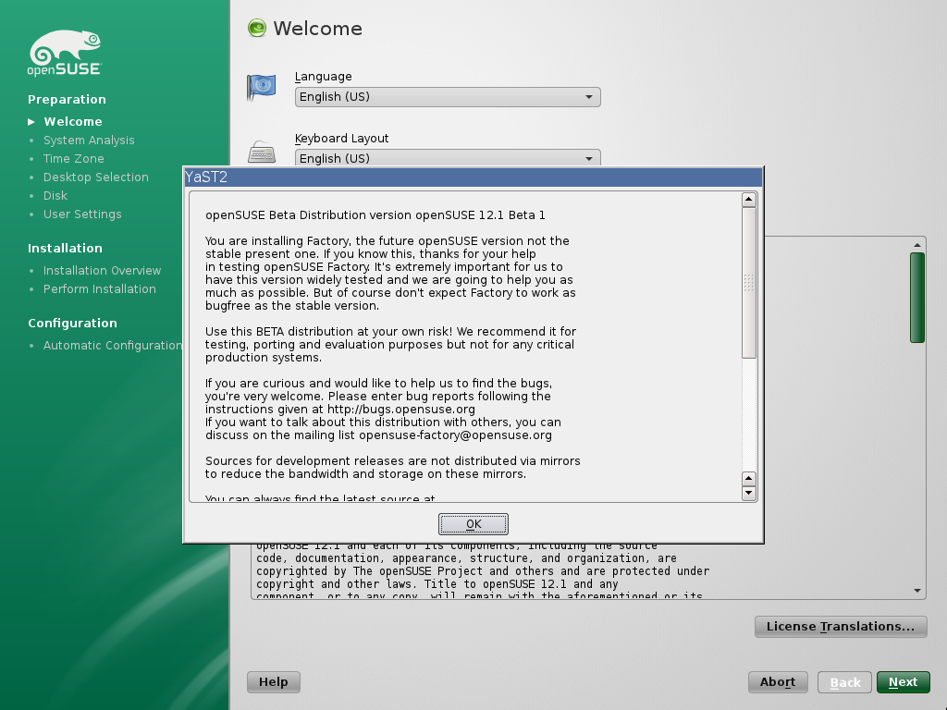
Screen shot as taken by the openQA automated testing framework
Notes:
Besides the screenshots openQA also offers video's of the whole process for download.

